Slide 1
Self-Help Enterprises
Climate Adaptation Features
San Joaquin Valley Regional Climate Adaptation Webinar

Slide 2
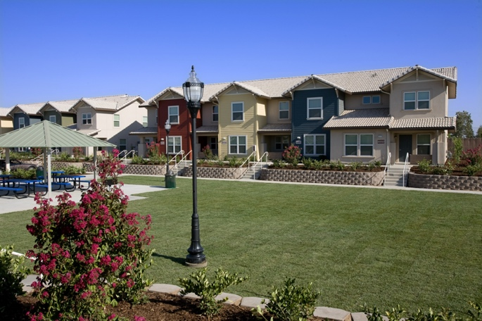
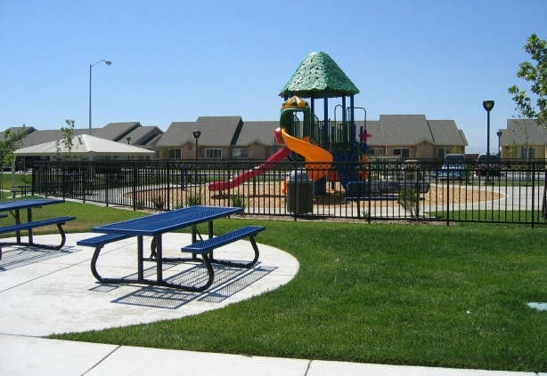
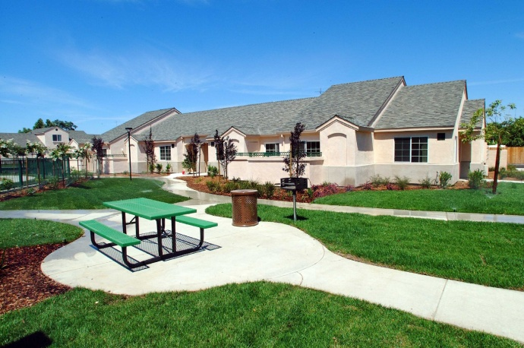
About Self-Help Enterprises…
Established in 1965
Helped more than 6,400 families to build their own homes & developed 1,900 units of rental housing
Work with over 60 community services districts or small water systems; active in the drought
Received two AHSC awards in round 2 and one in round 3
Implementing transportation, solar PV, graywater, etc.
Notes:
Parksdale Village I
13549 Wood St. , Madera CA, 93638
SHE reduced water consumption by 14% and still experienced a 102% Cost Increase over 12 months. In total, this represents a 189% rate increase from previous year of .070 to .202 (per Gallon).
Parksdale Village II
13600 Wood St. , Madera, CA 93638
SHE reduced water consumption by 60% and experienced only a 1% decrease in costs over 12 months. In total, this represents a 260% rate Increase from previous year of .063 to .227 (per Gallon).
Solinas Village
711 Fifth St., McFarland, CA 93250
SHE reduced water consumption by 6% and still experienced a 161% Cost Increase over 12 months. In total, this represents a 186% rate Increase from previous year of .014 to .040 (per Gallon).

Slide 3
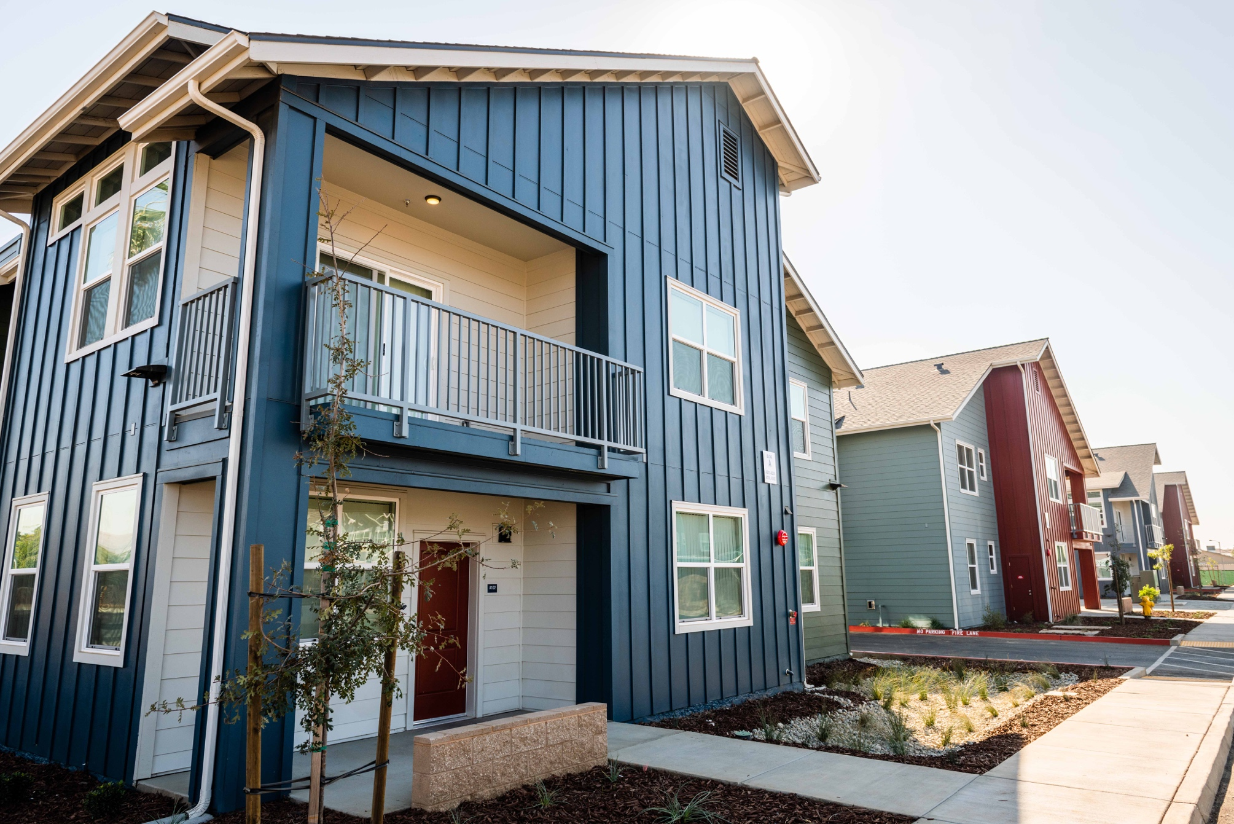
Palm Terrace – October 2018
Round 2 – AHSC – RIPA
Grey water for landscaping
Bioswales
Drought tolerant plants
Passive solar features
Miocar – electric ride share
Community Building as cooling center

Slide 4
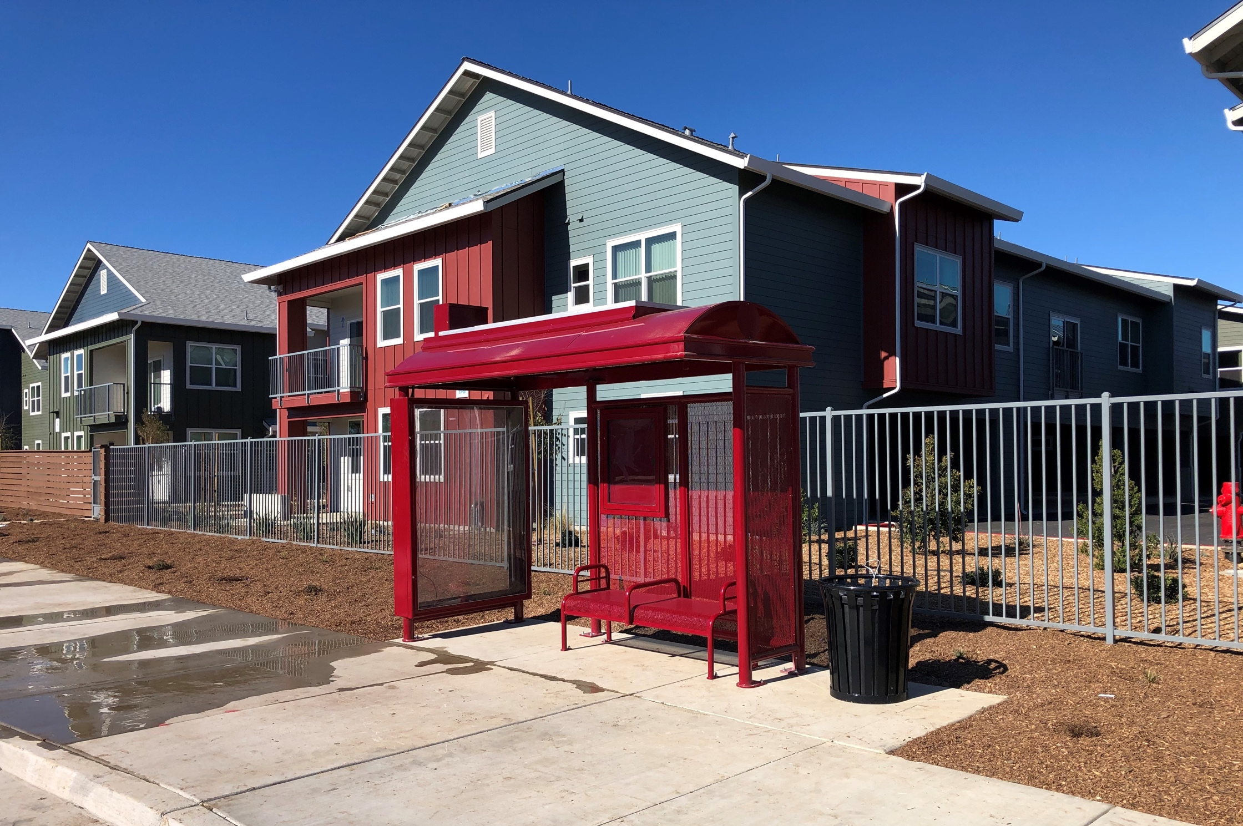
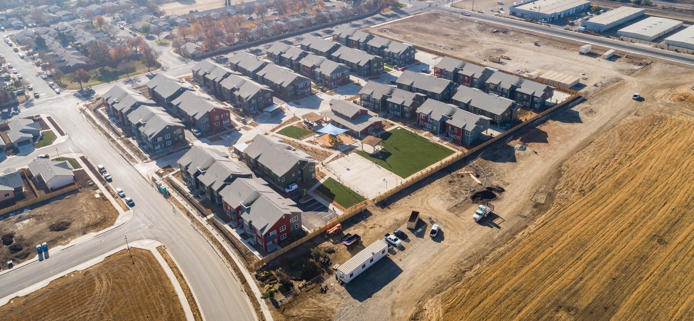
Stonegate Village I and II – March 2021
CalVans – expanding into Stanislaus
Active Transportation to schools and parks
New bus pullout and transit passes
100% solar offset of common and residential loads
VNEM Pilot project with electrical utility - TID
6 fast charge EV charging stations
Basin park for water recharge

Slide 5
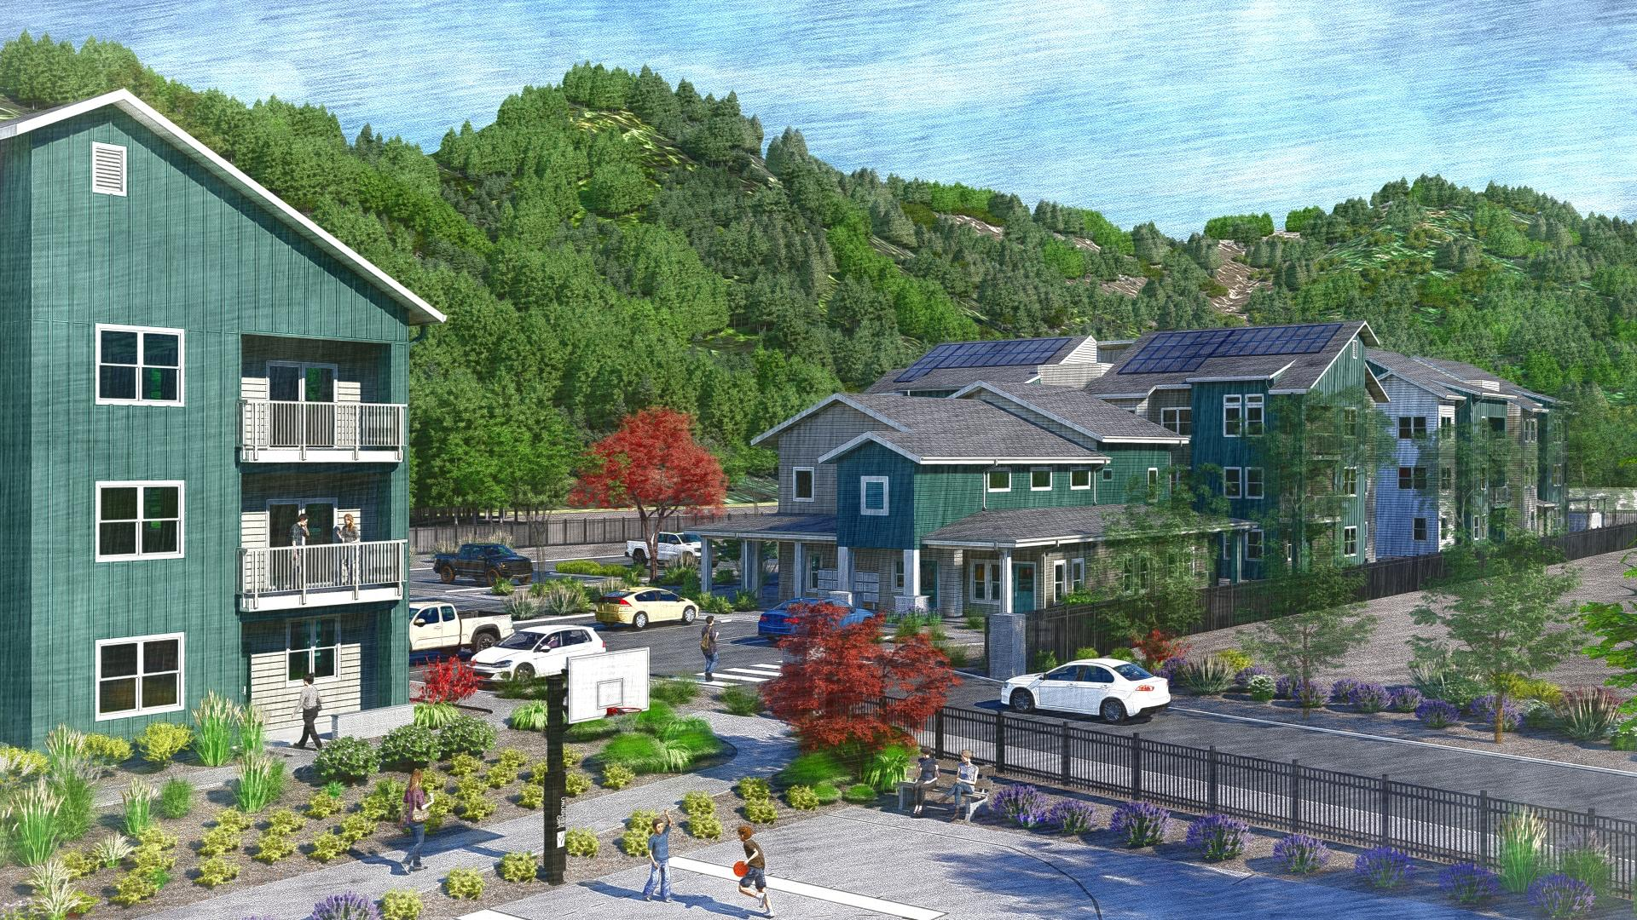
Creekside Terrace – under construction
Located in Mariposa county with increased risk of forest fire
Buildings oriented to the interior to allow no-burn buffer around buildings
Vegetation Management Plan
Leaf guards in gutters
No bark, uses decomposed granite in landscape areas

Slide 6
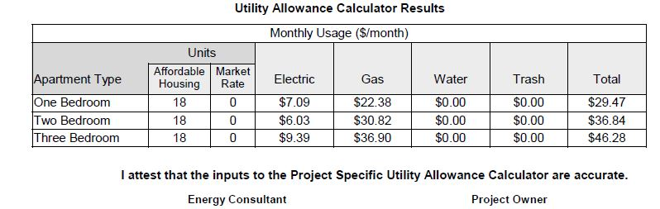
California Utility Allowance Calculator
Incentivizes energy efficiency for Affordable Housing projects compared to Utility Allowances

Slide 7
Looking forward
Opportunities and Challenges
Los Arroyos – hopefully our first all-electric zero net energy project
EV charging stations – state-wide infrastructure
Indoor air quality – Mervs 13 filters vs alternatives
Stormwater management and water recharge
Electrical infrastructure needs, cost, and tenant preference for gas appliance
Asset management desire to create secure site
Pluses and minuses of higher rated air filters
Land use and cost
Earth Blocks!?

Slide 8
Funding sources?
State sources
• AHSC
• IIG
• LIWP
Philanthropy
• Wells Fargo – AHBC – ex. sustainably sourced CLT timber
Utility Companies
• California Energy Commission – MF battery storage pilot
• PGE – EV charging stations

