Slide 1
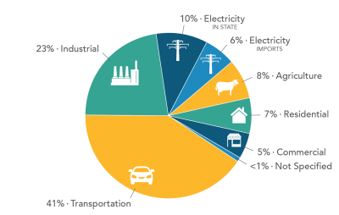
Air Quality Sources
Notes:
This is generally where emissions come from. While the contribution from various sources differs in different places, the interaction between these sources and land use is universal.

Slide 2


Sac Metro Air District Programs
Serving 11 low income housing developments in Sacramento County

Slide 3






Sac Metro Air District Incentives
Community Air Protection, Carl Moyer, FARMER, and SECAT

Slide 4
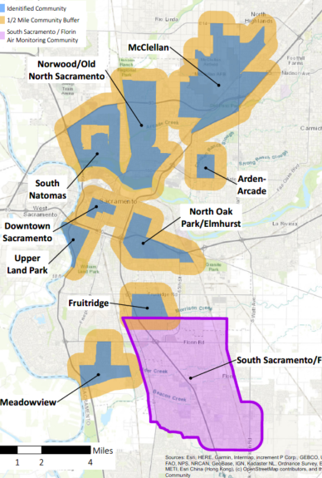
Sac Metro Air District Efforts
Incentives
CalEEMod update – Land Use & Transportation measures
Local jurisdiction land use involved in AB 617 steering committee
Funding flexibility: AB 617 CERP constraints with traditional funding

Slide 5
Interaction Between Land Use and Air Quality
Reduce Emission Sources
  Lower emissions at the sources to reduce impact on surrounding uses.
    Lower emission vehicles, equipment, appliances, etc.
Remove Emission Sources
  Change, remove, or plan for land uses that emit
    Change: convert from one existing use to a lower emitting source (example: industrial to commercial)
    Remove: eliminate existing emission source
    Plan: change future land uses to uses with fewer emissions or design the uses to lower the impacts from emissions.
Reduce Emission Impacts
  Lower exposure to emissions
    Provide ways to reduce exposure to emissions (example: trees, bus shelters, etc)

Slide 6
How Community Interacts with Land Use
General Plans – designated land uses in an area
Development Proposals – implementation of a land use plan with specific developments
Climate Action Plans – policies and procedures that reduce emissions from all sources

