Slide 1
CALIFORNIA REGIONAL CLIMATE ADAPTATION INITIATIVE
Understanding Climate Change in the Southern Desert Region; What Your Organization Can Do About It
Presented by Jonathan Parfrey

Slide 2
How will Imperial, eastern Inyo, Riverside and San Bernardino counties be impacted by climate change? (Answers form California’s Fourth Climate Change Assessment)

Slide 3
THE INLAND DESERT REGION IS WARMING. By mid-century (2041-2060) the region will likely warm by 4°F to 7°F above historic climatic temperatures.
OUR HEALTH IS IN THE BALANCE. Longer and more frequent high-heat days will increase the number of heat-related illnesses, such as heat stroke, heat cramps, heat exhaustion and dehydration, as well as other illnesses and premature deaths. Mortality risk for those 65 or older could increase ten-fold by the 2090s.
AT TIMES THERE WILL BE DROUGHT. Droughts will become more severe due to rising temperatures, increasing evaporation and decreasing soil moisture. This may be exacerbated by increased water demand due to higher heat.
AIR QUALITY WILL LIKELY WORSEN. Hotter future temperatures will also increase surface ozone concentrations.
MEETING ELECTRICITY DEMAND WILL BE CHALLENGING. Residential electricity demand is likely to grow due to bigger heat waves, and higher temperatures will likely affect electricity supply from gas-fired plants.
WE ANTICIPATE MORE DESTRUCTIVE WILDFIRES. Projections indicate that wildfires will increase throughout desert region. The most fire prone areas include the San Gorgonio Pass, gateway to the Coachella Valley, and the Cajon Pass leading to the Victor Valley. Strong winds in these areas play a vital role in the spread of wildfires.
FLOODING WILL BECOME A LARGER PROBLEM. Projected increases in precipitation could result in larger floods, mudslides and debris flows. Landslides could take place in the San Bernardino and San Jacinto mountains, where complex geology and fault zones intersect steep terrain prone to wildfire risk and heavy precipitation events
PRESERVING THE SALTON SEA. The future of the region is highly dependent on the fate of the Salton Sea, which is currently threatened by diminishing levels of inflows from agricultural runoff. As the Sea shrinks, the dry lakebed will grow. It will likely become a major source of dust, polluting the air of the region.

Slide 4
WAIT — THERE'S GOOD NEWS!
Central California governments have made progress to reduce greenhouse gas emissions and make plans to adapt to climate change. Many municipalities are updating their General Plans to include strategies that address climate mitigation and adaptation.

Slide 5
ACTION(S) TAKEN
Although the Inland Deserts will be impacted in many ways by a changing climate, the region already has specific plans in place to address those impacts with innovative solutions that will create more livable cities for everyone. Two pieces of legislation and two executive orders currently drive climate action in California.
SENATE BILL 32 (2016) requires California Air Resources Board (CARB) to reduce greenhouse gas emissions to 40% below 1990 levels by 2030.
SENATE BILL 100 (2018) commits California to achieving 100% renewable electricity by 2045.
EXECTUTIVE ORDER B-55-18 commits California to achieving carbon neutrality in every sector by 2045.
EXECTUTIVE ORDER N-82-20 sets aside 30 percent of California's land area to preserve wildlife habitat and protect against climate change.
1 All citations are from Langridge, Ruth. (University of California, Santa Cruz). 2018. Central Coast Summary Report. California’s Fourth Climate Change Assessment. Publication number: SUM-CCCA4-2018-006..

Slide 6
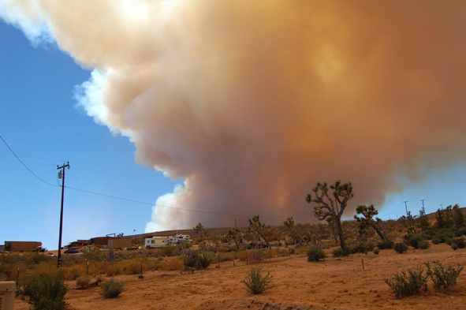
ACTION(S) TAKEN REGIONALLY
Leadership Counsel for Justice and Accountability based in the East Coachella Valley mobilizes community voices, advocates for sound policies, and eradicates injustice to promote equal access to opportunity regardless of race, income and place.
The City of Palm Springs Sustainability Plan outlines climate action and resilience strategies that prioritizes greenhouse gas reduction measures with co-benefits that make the community more resilient to climate change.
THE City of Calexico Climate Action Plan outlines policies and measures in the transportation, energy efficiency, renewable energy, and solid waste management sectors that the City will implement to reduce citywide GHG emissions. Highlighted measures include implementing policies that encourage walking and biking, safe routes to school programs, and gradually replacing city’s diesel vehicle fleet with CNG and EV buses.
The City of Brawley Climate Action Plan establishes strategies for reducing municipal and community-wide greenhouse gas (GHG) emissions. The City also amended their General Plan to include land use policies that encourage sustainable development. Highlighted policy amendments include: contribute to a reduction of vehicle miles traveled (VMT) through land use and zoning measures and conserve imported water by requiring water conservation techniques and water conserving appliances
The San Bernardino County Resilience Strategy Plan identified its most vulnerable and critical County sectors on key climate impacts to the region and proposed adaptation strategies to protect vulnerabilities. Highlighted strategies include: assisting individuals with restricted mobility to reach cooling centers, coordinate with the San Bernardino County homeless services to ensure that shelters are available during highly hazardous events, and integrating climate change adaptation into transportation plans.
On the regional level, cities and counties have identified actions and set targets to reduce GHG emissions and address climate change impacts. Here are a few examples:

Slide 7
DEFEND CLIMATE PROGRESS!
These climate action policies and others often come under attack from fossil fuel and other corporate interests. Above all else, the State’s existing climate policies need to be defended.

Slide 8
SO, WHAT’S NEXT?
Here are a few actions your community can take to prepare for the impact of climate change.
THE MAIN PROBLEM . . . WELL, IT’S CARS. The leading source of greenhouse gas emissions in California is from the transportation sector. How do we reduce those emissions? First, by building affordable housing near public transit corridors, and by creating neighborhoods that promote biking, scootering and walking. Another essential climate strategy is to encourage transition to electric and green-hydrogen fueled vehicles.
COMMUNITY CHOICE ENERGY. New municipal programs allow households to choose how much of their energy comes from renewable resources, thereby lowering greenhouse gas emissions and ensuring electricity grid resilience. Desert Community Energy in Palm Springs and Rancho Mirage Energy Authority are two local examples.
COOL DOWN NOW. Cool roofs cool-down buildings, protect the people indoors, reduce energy consumption and even reduce smog.
JOIN A CLIMATE COLLABORATIVE. The Inland Southern California Climate Collaborative (ISC3) is a membership organization fostering a network of local leaders throughout Imperial, San Bernardino and Riverside counties to address climate change mitigation and adaptation.
WATER IS LIFE. Take advantage of free water conservation initiatives provided by water utilities — these products not only lower water bills, they save greenhouse gas emissions and help communities become more resilient.
THIS AIN’T MARYLAND. Convert grass lawns with California-friendly landscaping. Turf conversion programs are often provided by local water utilities.
CHAMPION GOOD LEGISLATION. Every year there are bills on climate matters. For example, Assembly Bill 585 (2021), will help coordinate state action on urban cooling. Groups can join ARCCA and track climate bills.

Slide 9
THANK YOU!
Jonathan Parfrey
jparfrey@climateresolve.org

