Slide 1
CALIFORNIA REGIONAL CLIMATE ADAPTATION INITIATIVE
Understanding Climate Change in the San Joaquin Valley; What Your Organization Can Do About It
Presented by Jonathan Parfrey

Slide 2
How will the San Joaquin Valley be impacted by climate change? (Answers form California’s Fourth Climate Change Assessment)

Slide 3
THE SAN JOAQUIN VALLEY IS WARMING. By mid-century (2041-2060) the region will likely warm by 3°F to 6°F above historic climatic temperatures.
OUR HEALTH IS IN THE BALANCE. Longer and more frequent high-heat days will increase the number of heat-related illnesses, such as heat stroke, heat cramps, heat exhaustion and dehydration, as well as other illnesses and premature deaths. Outdoor workers are especially at-risk, especially farmworkers, which in turn threatens the local agricultural economy.
MORE FREQUENT AND SEVERE DROUGHTS WILL AFFECT AGRICULTURAL PRODUCTION. Constraints on water supplies, frequent and longer droughts, warmer temperatures, variable rain, new pests, and reduced chill hours will affect agriculture decisions and implementation.
AIR QUALITY WILL WORSEN. Hotter temperatures convert tailpipe emissions (nitrogen oxides) into ozone, which is linked with reduced lung function and exacerbating incidence of bronchitis, emphysema, and asthma.
AT TIMES THERE WILL BE MORE RAIN – BUT ALSO LESS SNOW. Climate change will reinforce variable precipitation trends, leading to longer periods of drought and more extreme periods of heavy rain..
WE ANTICIPATE EVEN MORE DESTRUCTIVE WILDFIRES. Projections indicate that wildfires may become more frequent and more destructive in the foothills above the San Joaquin Valley. Over- all burned area is projected to increase over 178% above traditional fires of the past.
FLOODING WILL BECOME A LARGER PROBLEM. The projected increase in precipitation extremes, alone and in combination with the projected increase in wildfires, creates increased potential for floods and mudslides.
MEETING ELECTRICITY DEMAND WILL BE CHALLENGING. Residential electricity demand is likely to grow due to bigger heat waves, and higher temperatures will likely affect electricity supply from gas-fired plants.

Slide 4
WAIT — THERE'S GOOD NEWS!
Local governments throughout the San Joaquin Valley have made progress to reduce greenhouse gas emissions and make plans to adapt to climate change. Many municipalities are updating their General Plans to include strategies that address climate mitigation and adaptation.

Slide 5
ACTION(S) TAKEN
SENATE BILL 32 (2016) requires California Air Resources Board (CARB) to reduce greenhouse gas emissions to 40% below 1990 levels by 2030.
SENATE BILL 100 (2018) commits California to achieving 100% renewable electricity by 2045.
EXECTUTIVE ORDER B-55-18 commits California to achieving carbon neutrality in every sector by 2045.
EXECTUTIVE ORDER N-82-20 sets aside 30 percent of California's land area to preserve wildlife habitat and protect against climate change.
Although the the San Joaquin Valley will be impacted in many ways by a changing climate, the region has specific plans in place to address those impacts with innovative solutions that will create more livable cities for everyone. Two pieces of legislation and two executive orders currently drive climate action in California.
Date cited from the Fifth Climate Change Assessment. San Joaquin Regional Report. Westerling, Leroy, Josue Medellin-Azuara, Joshua Viers. (University of California, Merced). 2018. San Joaquin Valley Summary Report. California’s Fourth Climate Change Assessment. Publication number: SUMCCCA4-2018-003.

Slide 6
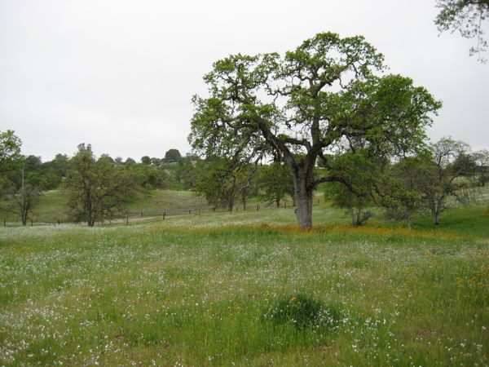
SELECT REGIONAL CLIMATE ACTIONS
Tulare County updated Climate Action Plan (2018) with goals to reduce CO2 emissions from transportation, energy, water transport and treatment, and agricultural activities. Emissions from these sources will be reduced by actions that increase the use of renewable and zero emission electricity from the grid from sources such as wind, solar, and hydroelectric.
The City of Stockton established a Climate Action Plan Advisory Committee in 2014 with representatives from environmental, nonprofit, labor, business, and developer interest to inform climate mitigation and adaptation strategies..
The Sustainable Energy Roadmap for the San Joaquin Valley (SER) brought together 14 San Joaquin Valley jurisdictions with regional planning agencies, industry sources, and technical experts. They exchanged ideas on energy and water efficiency, renewable energy and storage, sustainable transportation and land use, and social equity. Each community prepared an action plan for each topic addressing policies, permitting, planning and zoning, financing, market development, and workforce development.
The 25x25 Initiative and the San Joaquin Valley Clean Energy Organization (SJVCEO)) have joined efforts to encourage renewable energy use and development in the San Joaquin Valley. The SJVCEO was established by the Energy Work Group of the California Partnership for the San Joaquin Valley to lead a regional effort to develop, plan and implement energy efficiencies and clean energy.
At the regional level, cities and counties have identified actions and set targets to reduce GHG emissions and address climate change impacts. Here are a few examples:

Slide 7
DEFEND CLIMATE PROGRESS!
These climate action policies and others often come under attack from fossil fuel and other corporate interests. Above all else, the State’s existing climate policies need to be defended.

Slide 8
SO, WHAT’S NEXT?
Here are a few actions your community can take to prepare for the impact of climate change.
THE MAIN PROBLEM . . . WELL, IT’S CARS. The leading source of greenhouse gas emissions in California is from the transportation sector. How do we reduce those emissions? First, by building affordable housing near public transit corridors, and by creating neighborhoods that promote biking, scootering and walking. Another essential climate strategy is to encourage transition to electric and green-hydrogen fueled vehicles.
COMMUNITY CHOICE ENERGY. New municipal programs allow households to renewable energy, thereby lowering greenhouse gas emissions. Present in many communities throughout California, municipalities in the San Joaquin Valley have explored but not signed-on to hosting community choice utiltities.
COOL DOWN NOW. Cool roofs cool-down buildings, protect the people indoors, reduce energy consumption and even reduce smog.
JOIN A CLIMATE COLLABORATIVE. There are now climate collaboratives representing 90% of California municipalities but not the San Joaquin Valley. The Alliance of Regional Collaboratives for Climate Adaptation (ARCCA) has long sought to create a climate collaborative in the San Joaquin Valley, but cannot stimulate local interest.
WATER IS LIFE. Take advantage of free water conservation initiatives provided by water utilities — these products not only lower water bills, they save greenhouse gas emissions and help communities become more resilient.
THIS AIN’T MARYLAND. Convert grass lawns with California-friendly landscaping. Turf conversion programs are often provided by local water utilities.
CHAMPION GOOD LEGISLATION. Every year there are bills on climate matters. For example, in 2021, Assembly Bill 585 made its way into the budget trailer bill, prodding new programs on urban cooling. Groups can join ARCCA and track climate bills.

Slide 9
THANK YOU!
Jonathan Parfrey
jparfrey@climateresolve.org

