Slide 1
Community Resource Project: An Overview
Luis Sanchez, CEO
February 18, 2021

Slide 2
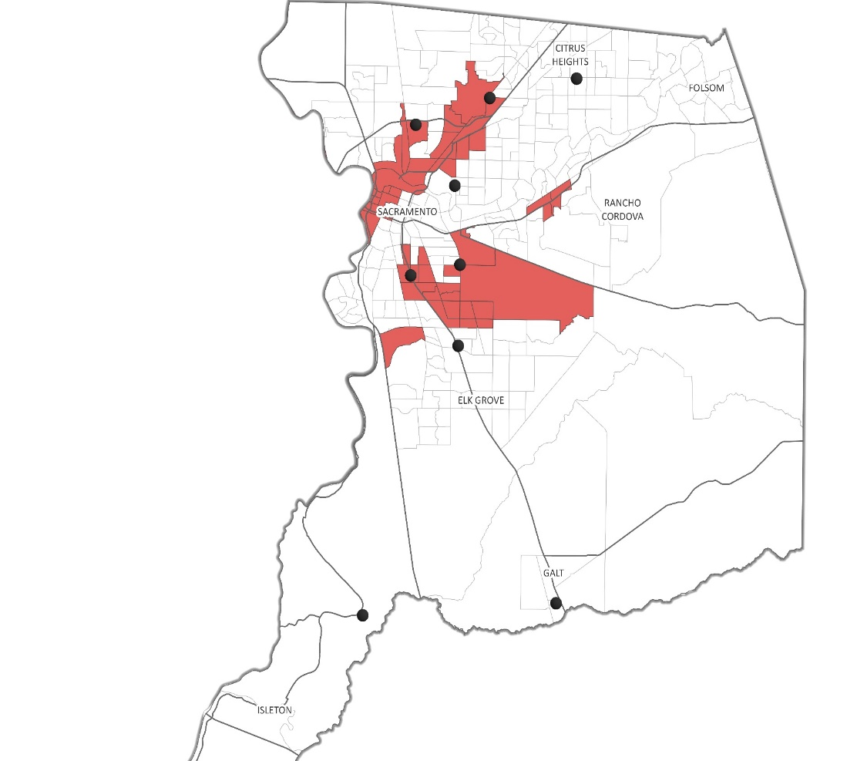
Who are We?
Sacramento based non-profit 501 c (3)
Founded in 1972
Serving the Sacramento, Sutter, Yolo, and Yuba Counties
Women/Minority Business Enterprise
Serving Low-Income and Disadvantaged Communities
CRP Office
Disadvantaged Community (SB 535)
Our mission is to improve opportunities for people in need through energy efficiency, health, and education
We envision healthy and economically stable communities, where everyone can realize a high quality of life

Slide 3
Approach to Climate Change Readiness
Home Energy Efficiency
Electric Vehicle Adoption
Workforce Development

Slide 4
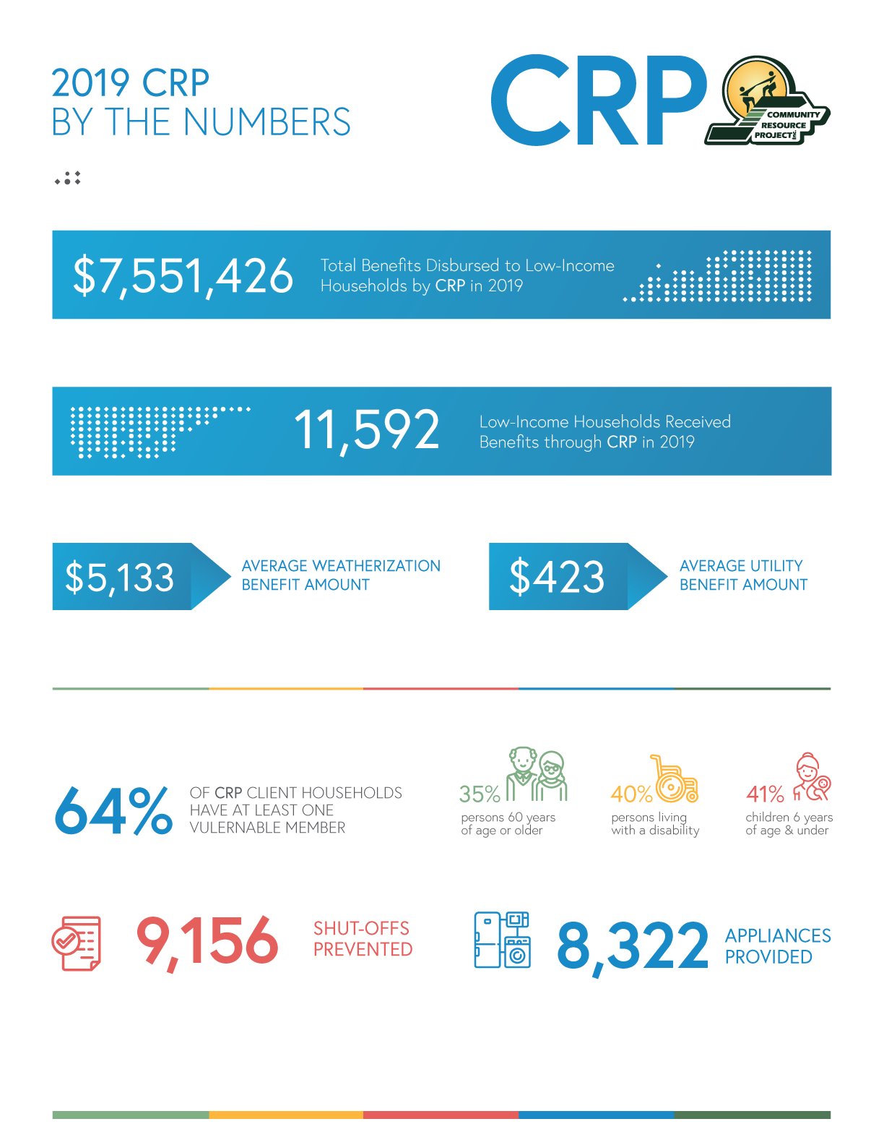
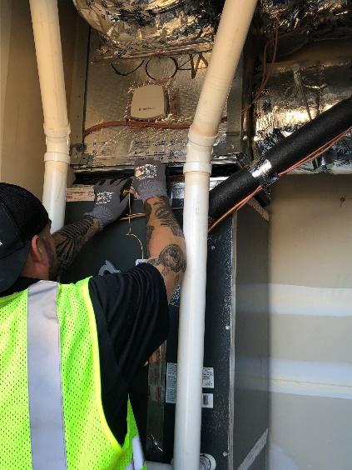
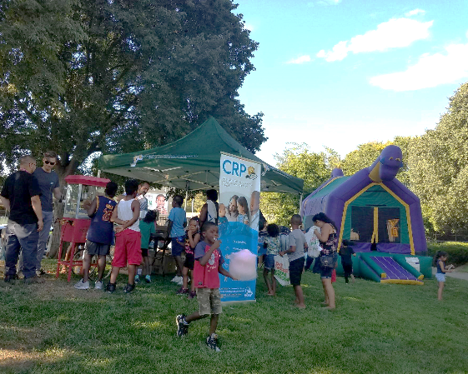
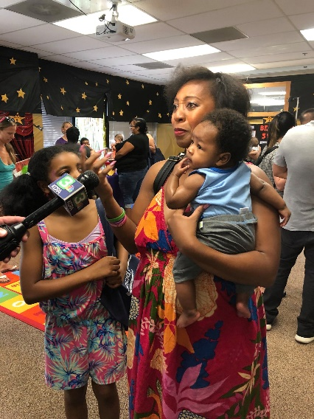
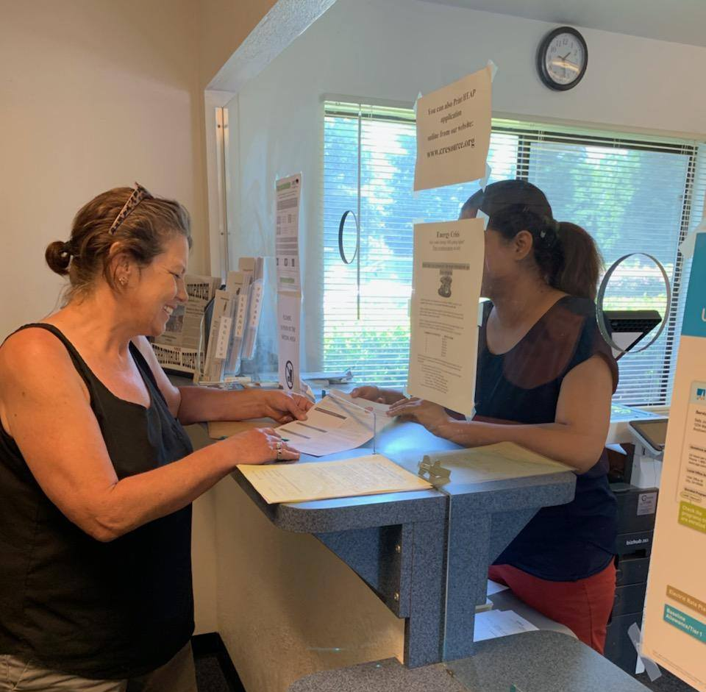
2019

Slide 5
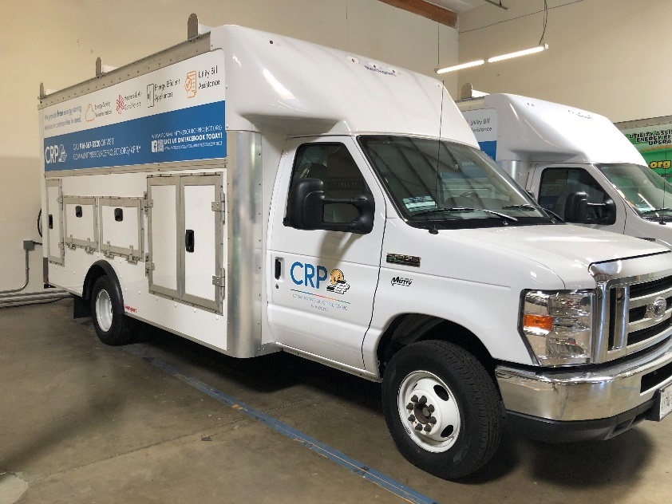
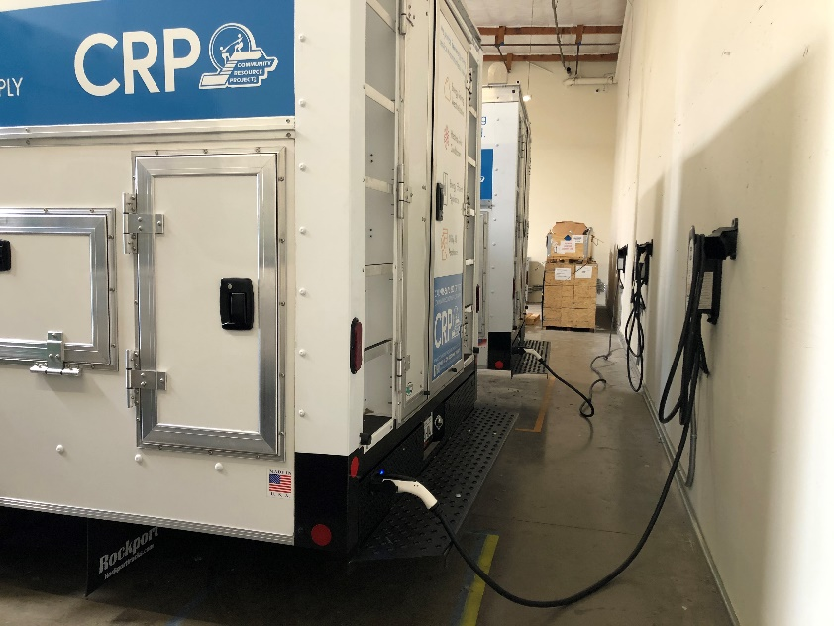
EV Fleet Replacement
Received funding for 9 EVs – Work ports and Box Trucks
Used to delivery materials to client’s households
Replaced 4-5 aging/polluting vehicles

Slide 6
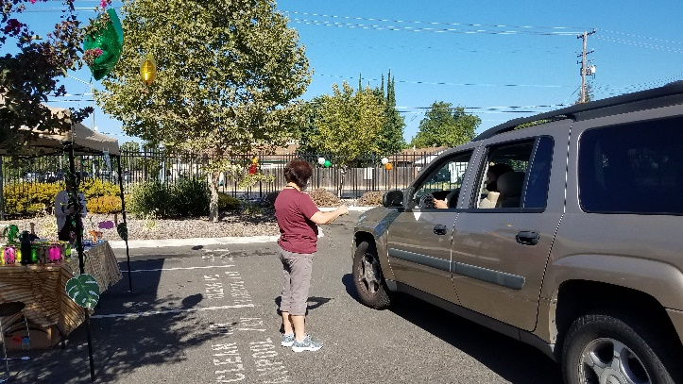
EV Ambassadors
Clean Vehicle Rebate Project
Conduct outreach in DACS to broaden awareness and EV adoption to residents of the community
Up to $7,000 in rebates for the purchase or lease of a new, eligible zero-emission or plug-in hybrid light-duty vehicle.
Outreach Strategies:
Direct outreach: Events, flyers, webinars/workshops
Indirect outreach: monthly newsletters, social media

Slide 7
Community Mobility Option Voucher Program: Overview
Voucher-based funding for zero-emission carsharing, carpooling/vanpooling, bikesharing/scooter-sharing, innovative transit services, and ride-on-demand services in California’s historically underserved communities.
CRP awarded funds to complete a Community Transportation Needs Assessment in South Sacramento neighborhoods to support a Rideshare Program
Assessment will Identify transportation gaps, needs, and preferences for unemployed and underemployed
Engage with local high school students to act as community ambassadors and as surveyors utilizing online map-based surveys
Notes:
development and is well-positioned to engage the community in the need assessment and
propose solutions. We will use at least two methods of engagement including hiring and
training local student ts to act as community ambassadors and directly interviewing
unemployed and underemployed residents as well as online map-based surveys. Our
approach will be sensitive to Covid-19 crisis rules and regulations by not requiring face-to-face
communication. We will also engage community-based organizations who provide affordable
job training for disadvantaged populations. The community-based organizations and
community ambassadors will help us to notify the residents and stakeholders. We will
increase access to job and training centers. Our approach will include surveys, interviews,
hiring local community ambassadors, and developing online engagement tools. Our program
will address high rates of unemployment in the area by providing clean mobility options for
local residents. The proposed ride-sharing, micro-transit program (“PlanShareGo”) will
provide access to job training and job centers to local unemployed and underemployed
residents. We will engage with residents, businesses, and other stakeholders who may benefit
from a new clean mobility service in the community.

Slide 8
Community Mobility Option Voucher Program
Address high rates of unemployment in the area by providing clean mobility options for local residents to get to and from work, or training facilities.
The proposed ride-sharing, micro-transit program (“PlanShareGo”) will provide access to job training and job centers to local unemployed and underemployed residents.
Engage with residents, businesses, and other stakeholders who may benefit from a new clean mobility service in the community.
Service area near Louise A. Perez Resource Center – 3835 41 Avenue. Sacramento

Slide 9
CRP RideShare Program | About
Community Resource Project, Inc.
Project Area
Four underserved census tracts in South Sacramento
Background on Community
Approximately 18,000 residents
Predominantly Hispanic
SB 535 Disadvantaged Community
AB 1550 Low-Income Community
High unemployment, poverty & asthma
Limited affordable and clean transportation options
Project Goal
Understand residents’ transportation needs and find a suitable clean mobility solution
Awardee Photo, Map of Project Area, or graph/chart
Use proper color contract for any graphs or charts
Check color contrast: https://www.tpgi.com/color-contrast-checker/
Notes:
Template Slides

Slide 10
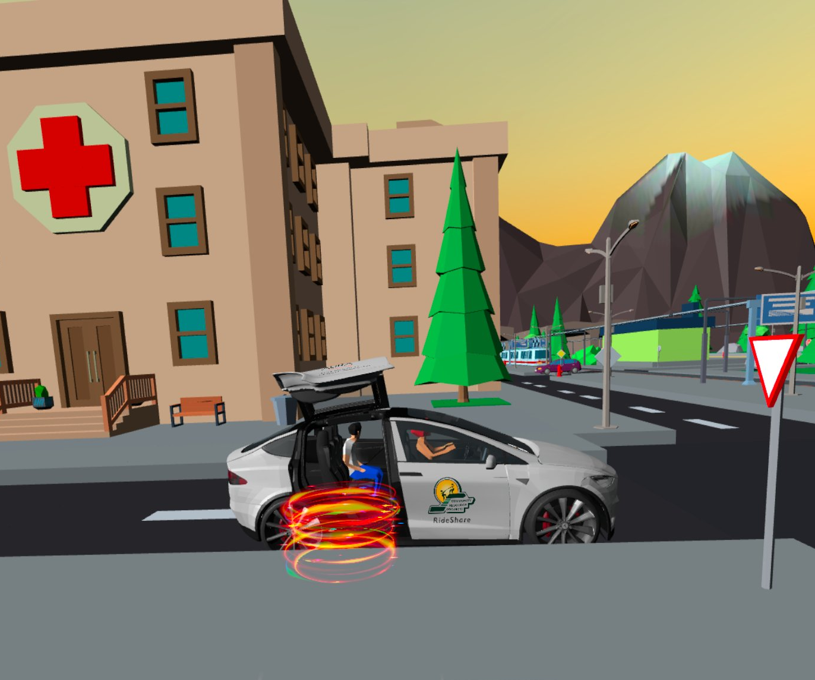
CRP RideShare Program | Methods
Community Resource Project, Inc.
Awardee Photo, Map of Project Area, or graph/chart
Make sure to include alternative text for all maps, images, graphs, etc.
Partnerships
Aura Planning, Inc.
Methodology
Transportation Access Data Analysis Strategies (4) – Map-based Survey, Transit Accessibility Index, National Walkability Index, & LEHD-LODES.
Community Engagement Strategies (4) – Previous Survey Data, Analysis, Driver-passenger Interviews, And Virtual Reality Focus Groups.
Challenges
Educating community on rideshare
Recruiting target audience
Maintaining COVID-19 safe protocols
Notes:
Template Slides

Slide 11
CRP RideShare Program | Findings
Community Resource Project, Inc.
Findings/Outcomes
Public transit is limited and unreliable
Walking is not a safe or desirable option
Owning/maintaining a car is a major financial burden
Majority of households own 3 or more cars
Majority of residents work outside the community and said they would use rideshare for work
Impact Metrics
20% of focus group participants said they would use rideshare because of its cumulative environmental benefits
Highlights
Support for an electric, rideshare program already exists
A local rideshare program should be affordable (priced lower than commercial rideshare) and prioritize passenger safety (women, children, and immigrant groups)
Needs Assessment showed that:
96%
of survey participants drive
as their main mode of transportation
56%
of requested rideshare
trips were for work
Notes:
Template Slides

Slide 12
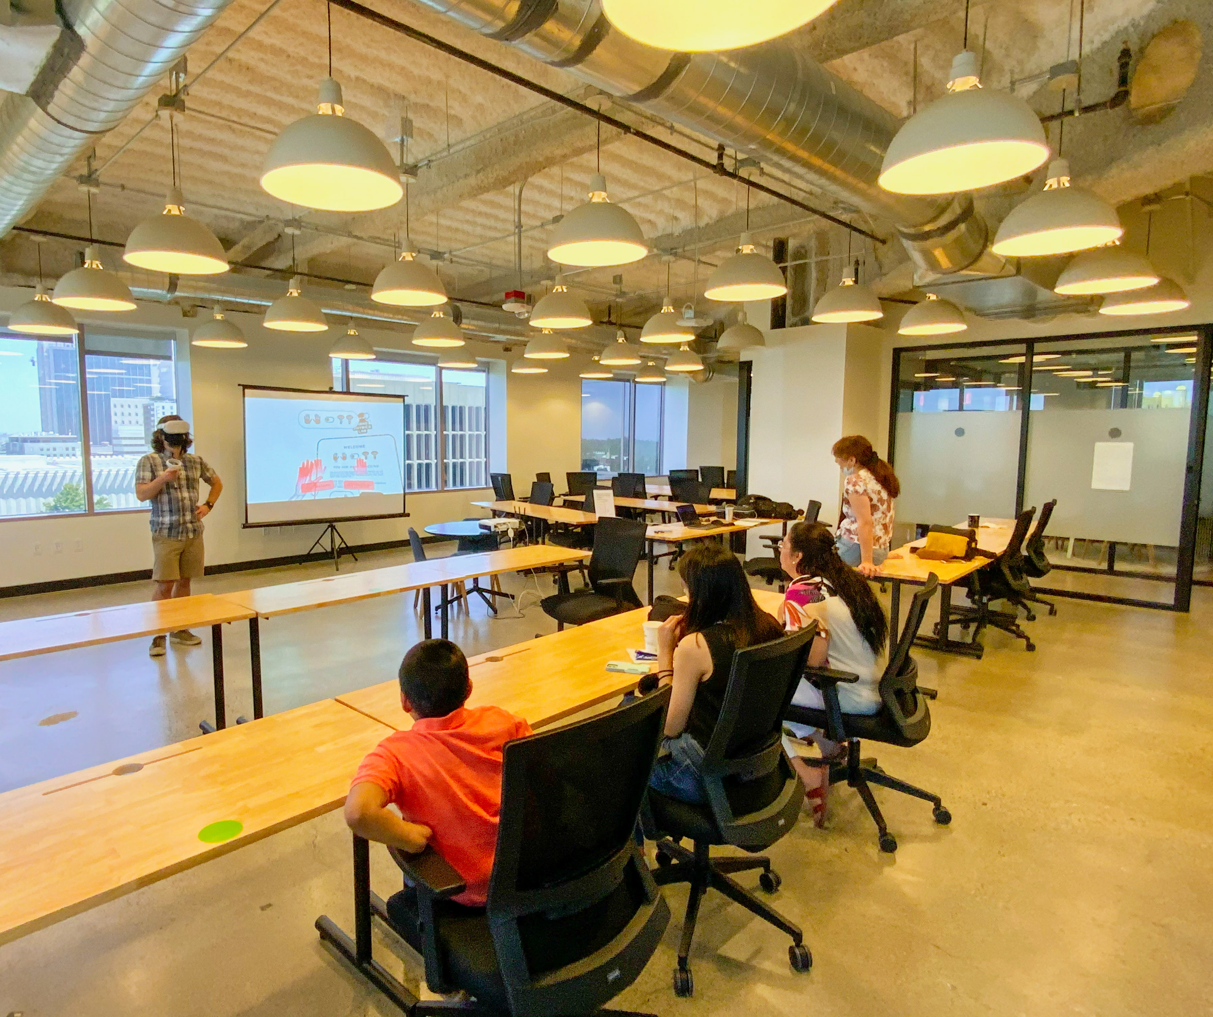
CRP RideShare Program | Lessons Learned
Community Resource Project, Inc.
Lessons Learned
Virtual reality is an effective way to help communities understand electric vehicles and shared mobility
Neighborhood-based mobility hubs with clean, shared mobility options can help meet communities’ needs
Next steps
Further community engagement
Building partnerships with other CBOs and government entities.
More Information
www.auraplanning.com/cmo-rideshare
Awardee Photo, Map of Project Area, or graph/chart
Google Slides: right-click on image, click “alt text”, add title and description (~100-125 characters)
MS Powerpoint: right-click on image, click “edit alt text …”, add description (~100-125 characters)
Notes:
Template Slides

Slide 13
Approach to Climate Change Readiness
Home Energy Efficiency
Electric Vehicle Adoption
Workforce Development

Slide 14
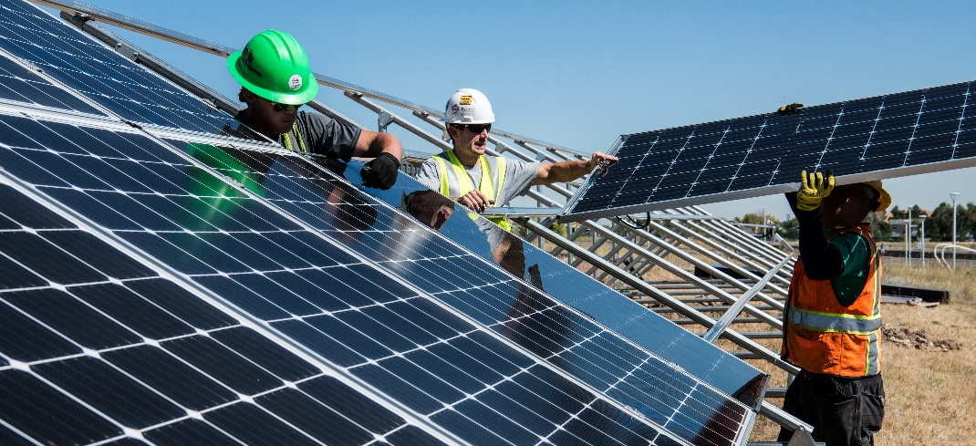
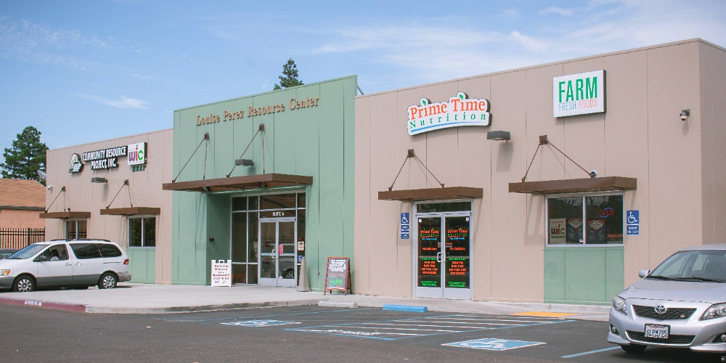
Future Opportunities
Workforce Development Program
Expand involvement in Solar/electric unit appliance installation
EV Charging Infrastructure at Louise Perez Resource Center
COMMUNITY RESOURCE PROJECT

